Slide 1

GDP-I Midterm Presentation
Team Members:
Kopparthi Sai Dinesh
Chepuri Tagore Charith,
Emani Aasrita,
Dasari Vamshika,
Maddela Tejaswi,
Veldanda Sailaxmi

Slide 2
Contents
Work Completed
Requirement Gathering
Defining Scope and Objectives
Wireframes Design and Creation
Navigation for Wireframes
Research into Development Environment Setup
Defining System Architecture
Contribution
3. Work to Complete in Next Weeks

Slide 3
Work Completed – Requirement Gathering
Develop a user-friendly institutional Android Application with the following components:
Login screen
Department Screen
Programs Screen
Course Screen
Assignment Screen
Student Dashboard Screen
Program that manipulates data in multiple CSV files to create a single CSV that stores relevant data.
Based on the role of person (Administrator, Instructor, and Student) who sign in into the application, the data being displayed in the application needs to be changed.

Slide 4
Work Completed – Defining Scope and Objectives
Weekly objectives
Week 1 - 2 : Requirement gathering, defining scope and objectives
Week 3 - 4: Wireframes Design and Creation
Week 5 - 9: Development Environment Setup
Week 10 - 12: Development - User Authentication and Navigation
Week 13 - 15: CSV Parsing and Data Processing

Slide 5
Work Completed – Wireframes Design and Creation
Selected Figma for the creation of wireframes. Utilized online tutorials and resources to understand Figma's capabilities.
Interactive wireframes for three fourth of the screens of the application were created, which include:
Login Screen
Departments Screen
Programs Screen
Courses Screen
Notes:
Tool used and how every team-mate learned the tool
No of wireframes created

Slide 6
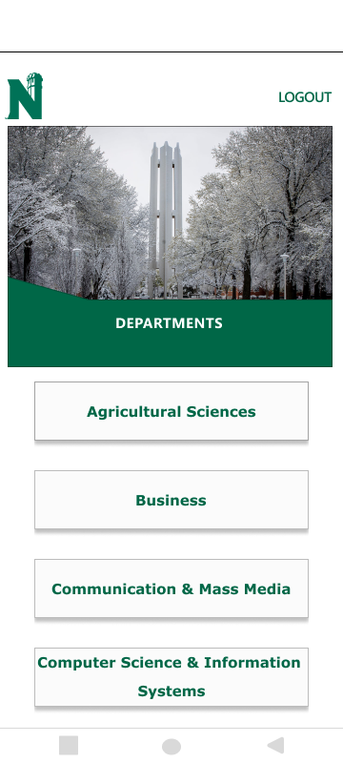
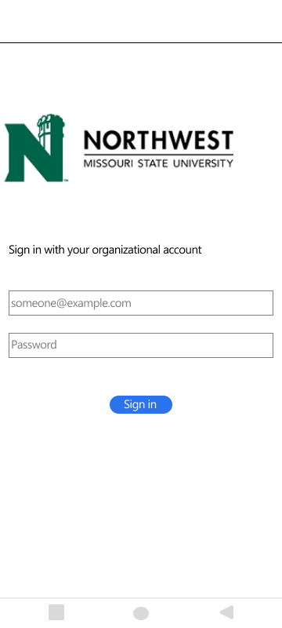
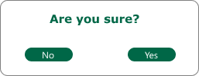
Work Completed – Wireframes Design and Creation
Stays on the same page
Redirects to home page
Text fields to enter Username and Password
Sign in Button: Validates Credentials and takes to home page
View to select departments
Login Screen
Departments Screen

Slide 7
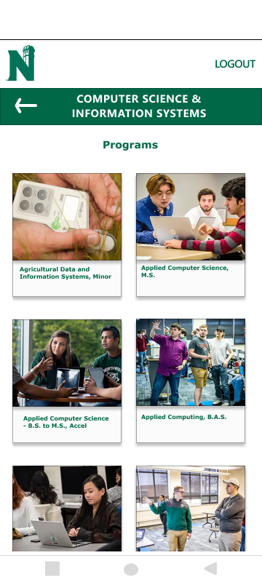
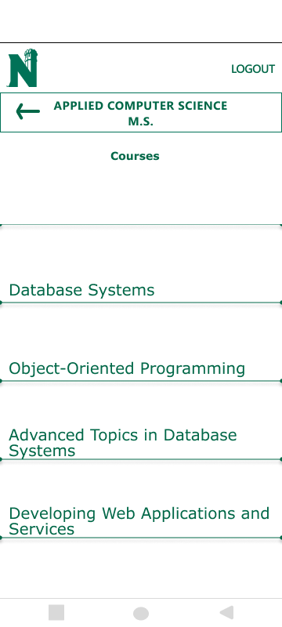
Work Completed – Wireframes Design and Creation
Redirects user to previous screen
View to select Program
View to select Course
Programs Screen
Courses Screen

Slide 8
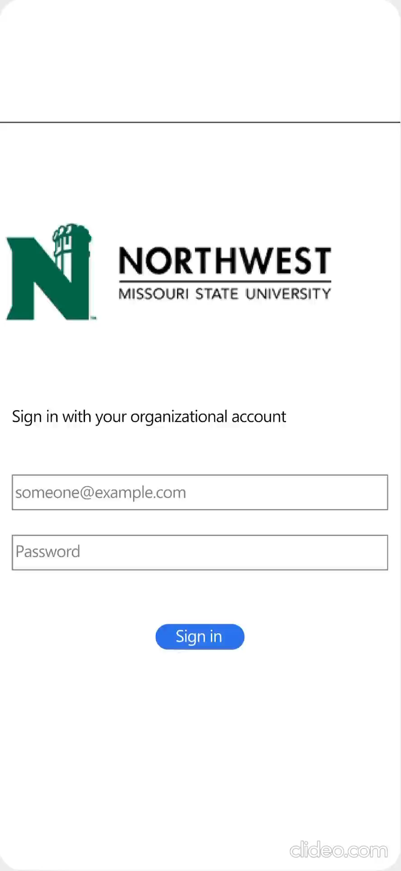
Work Completed - Navigation for Wireframes

Slide 9
Work Completed - Research into Development Environment Setup
Branch Workflow:
Create two main branches - master and development.
Team members create feature branches from development for their work.
Work is done in these feature branches to isolate changes.
Collaboration and Review:
After completing work, initiate a merge request from the feature branch to development.
Team reviews changes, ensuring code quality and functionality.
If approved, merge into development; else, iterate on improvements.
Stable Releases:
Periodically merge development into master to create stable releases.

Slide 10
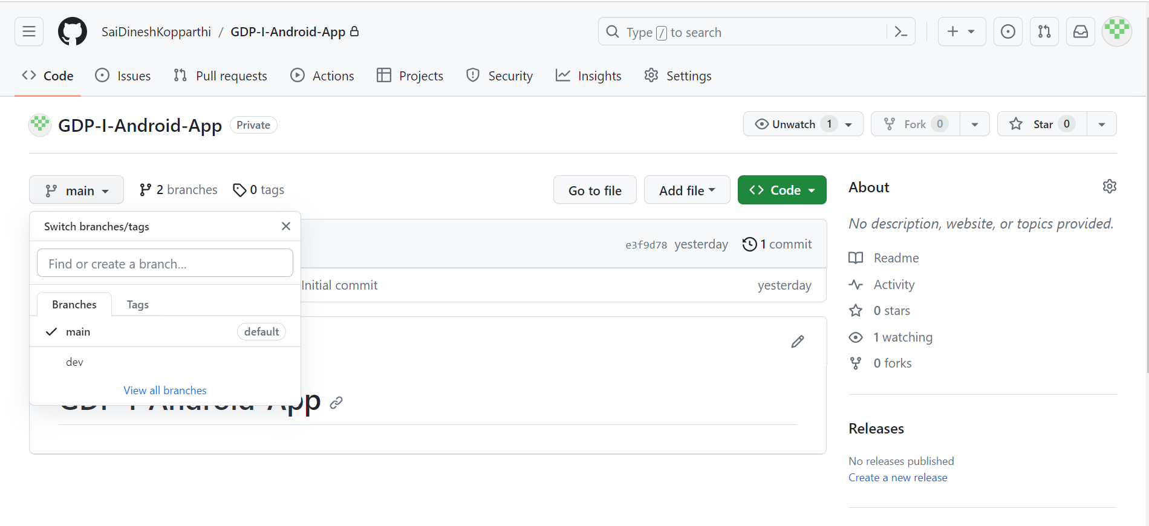
Work Completed - Research into Development Environment Setup
Branch ‘main’ : Source code hosting.
Branch ‘dev’: Branch for development.

Slide 11
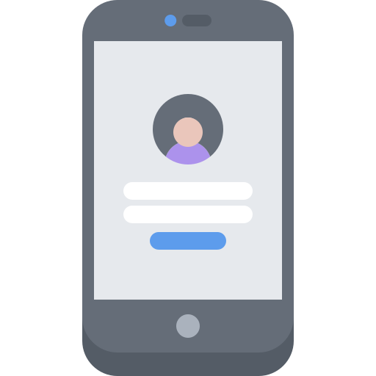


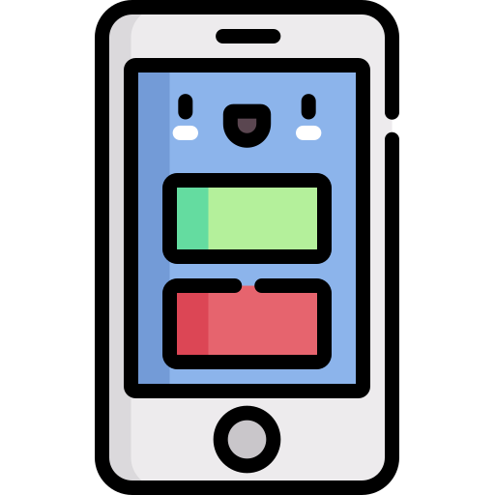
Work Completed – System Architecture
Frontend
Backend
Authentication
Server
Database
User Interface

Slide 12
Work Completed – System Architecture
Proposed Tools and Technologies:
User Authentication:
Firebase Authentication: A popular authentication service by Google that provides secure user sign-ins.
User Interface:
XML Layout: To define the structure and appearance of UI components within Android app screens.
Server:
Node.js: Backend frameworks for server development.
Database:
Firebase Realtime Database, SQLite: Database for server-based data.
Data Parsing:
Java: CSV parsing using libraries like Apache Commons CSV.
Python: Built-in ‘csv’ module.

Slide 13
Contribution
Kopparthi Sai Dinesh
Developing designs for both the departments and programs screens.
Conducting research pertaining to the establishment of a development environment.
Setting up of git repository and implementing required branch settings.
Chepuri Tagore Charith
Compiling the design elements for the departments screen to finalize the wireframe.
Designing the navigation structure for the wireframes.
Research into tools and technologies and develop environment.
Veldanda Sailaxmi
Collecting data pertaining to the departments and programs at Northwest Missouri State University and storing it in an Excel file.
Designing and compiling the elements for the courses screen to finalize the wireframe.
Defining the system architecture for the application.

Slide 14
Contribution
Emani Aasrita
Designing and implementing the wireframe for the application's login screen.
Assembling the design elements for the program screen and courses screen.
Defining the system architecture for the application.
Dasari Vamshika
Compiling the design elements for the programs screen to finalize the wireframe.
Designing the navigation structure for the wireframes.
Research into tools and technologies for the application.
Maddela Tejaswi
Collecting data pertaining to the departments and programs at Northwest Missouri State University and storing it in an Excel file.
Assembling the design elements for the program screen and courses screen.
Research into tools and technologies for the application.

Slide 15
Work to Complete in Next Weeks
Research into detailed technology stack required for each component of the project.
Create Android Project with perfect configuration.
Create XML Layouts for the application screens.

Slide 16
THANK YOU

